Slide 1
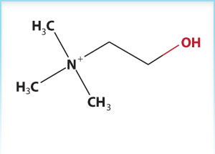
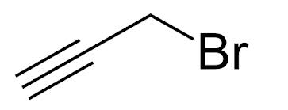
What is the hybridization state of the atoms in these molecules?
Propargyl Bromide
Choline
Notes:
I expect you to demonstrate that you understand basic concepts of chemical bonding

Slide 2
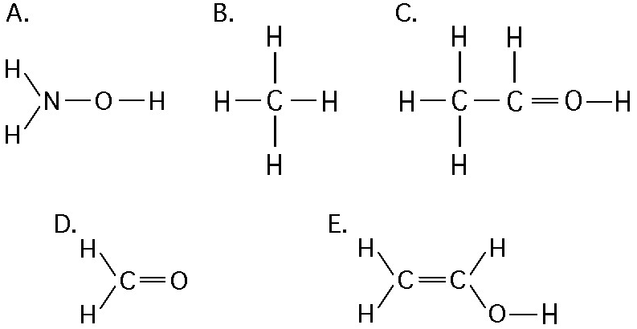
Which of these molecules doesn’t work?
Notes:
Demonstrate that you understand the rules that define stable molecules

Slide 3
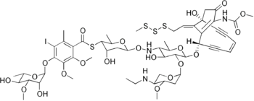
Is there anything wrong with this molecule?
Notes:
Demonstrate that you understand the rules that define stable molecules

Slide 4
What happens when the Gibbs free energy is zero?
Notes:
I expect you to know basic thermodynamic concepts and their relationship to enzymes

Slide 5
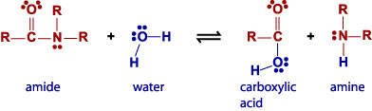
Push the arrows in this reaction:
Notes:
I expect you to be able to do arrow pushing for simple enzymatic reactions

Slide 6

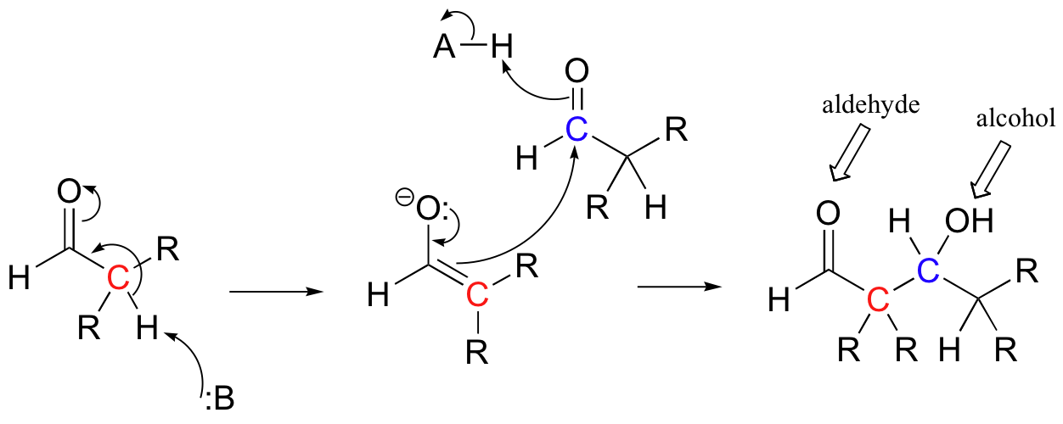
What happens in this mechanism?
Notes:
I expect you to know the reaction mechanisms for reactions we talk about in great detail such as aldol and claisen condensations

Slide 7
What does the following code do?
var anobject = {};
anobject.name = “bob”;
function execute(obj) {
println(“I have “ + obj.name);
}
execute(anobject);
Notes:
I expect you to know how to read some code and understand what it does

Slide 8
Describe in json a human being’s personal information that includes their contact information of various sorts.
Notes:
I expect you to understand at least how to read the JSON notation and model familiar objects

Slide 9
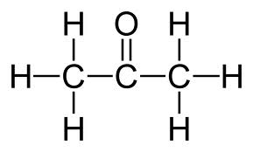
Describe the following molecule as a Graph:
Notes:
You should be able to describe a molecule as a graph

Slide 10
What is the relationship between my two hands?
Notes:
You should understand basic terminology and concepts behind stereochemistry

Slide 11
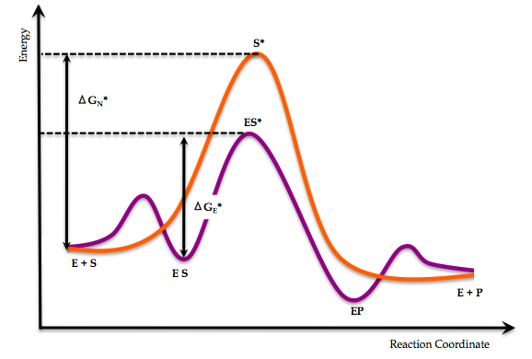
In this energy diagram, where is Kcat?
Notes:
You should understand michaelis-menton concepts and their relationship to thermodynamic concepts

Slide 12
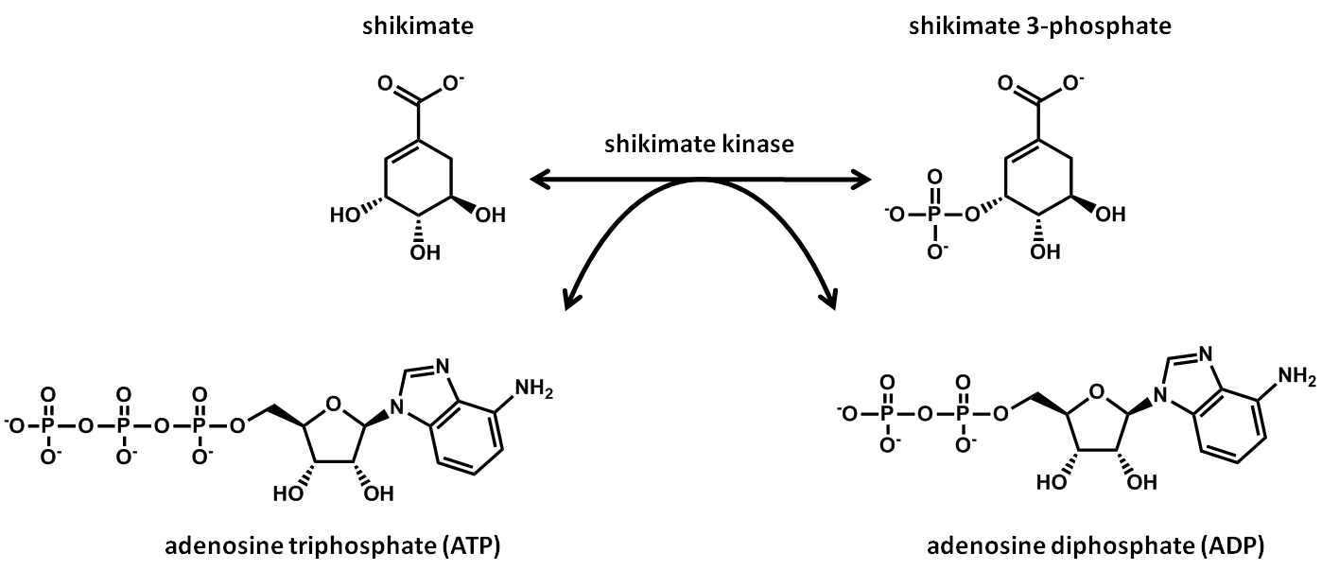
What’s an example of an enzyme that does the bi-bi mechanism?
Notes:
You should understand what is meant by ‘bi-bi’

Slide 13
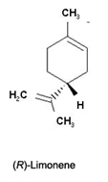
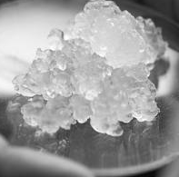
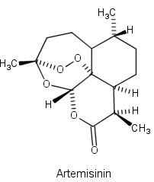
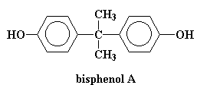
Which of the following is a catabolic process?
Fermentative production of artemisinin
Bioremediation of bisphenol A
Conversion of feathers to limonene
Nanocellulose production
Nanocellulose
Notes:
You should understand the terms catabolism and anabolism

Slide 14
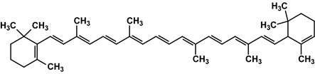
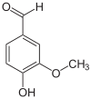
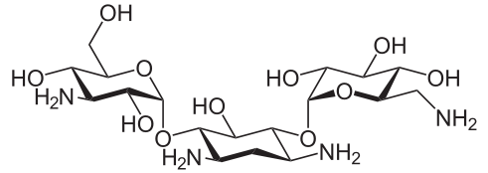
Which of the following is unlikely to be the substrate of a glucosyltransferase?
A) Beta-carotene
B) Vanillin
C) Kanamycin
Notes:
You should be familiar with the major enzyme classes and be able to identify their utility in the production of certain chemicals

Slide 15
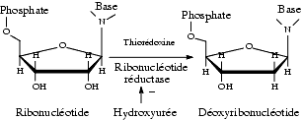
What kind of enzyme is this?
EC 1 Oxidoreductases
EC 2 Transferases
EC 3 Hydrolases
EC 4 Lyases
EC 5 Isomerases
EC 6 Ligases
Notes:
You should understand these 6 classifications of enzymes

Slide 16
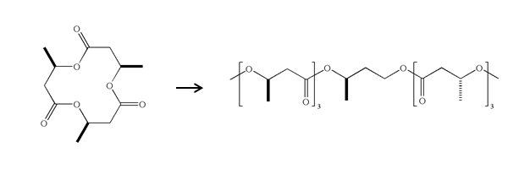
What kind of enzyme is this?
EC 1 Oxidoreductases
EC 2 Transferases
EC 3 Hydrolases
EC 4 Lyases
EC 5 Isomerases
EC 6 Ligases
Notes:
That was a trick question, but getting at the same point of understanding these 6 classes

Slide 17
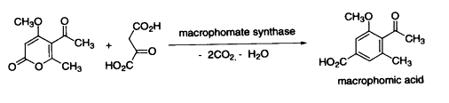
What kind of enzyme is this?
EC 1 Oxidoreductases
EC 2 Transferases
EC 3 Hydrolases
EC 4 Lyases
EC 5 Isomerases
EC 6 Ligases
Notes:
Again, understand the EC classes

Slide 18
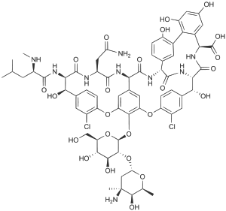
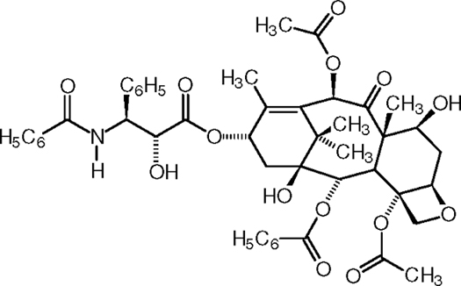
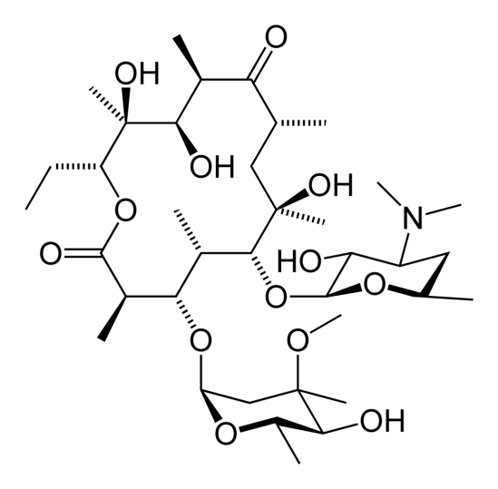
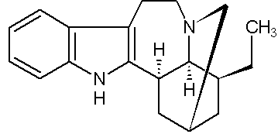
Which of the following are glycosides?
A) Vancomycin
B) Paclitaxol
C) Ibogamine
D) Erythromycin
Notes:
You should understand terms like ‘glycoside’ ‘terpenoid’ ‘polyketide’ and be able to recognize them in a molecule

Slide 19
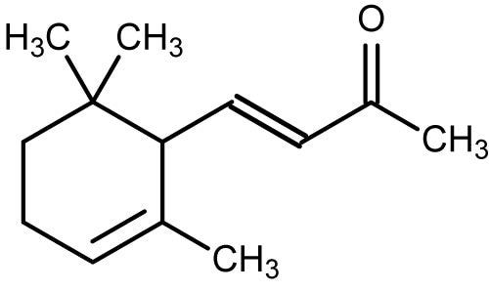
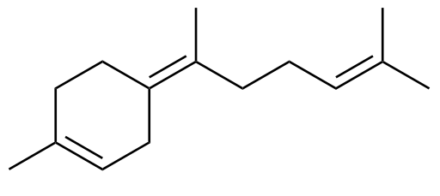
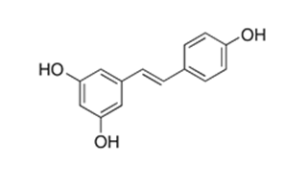
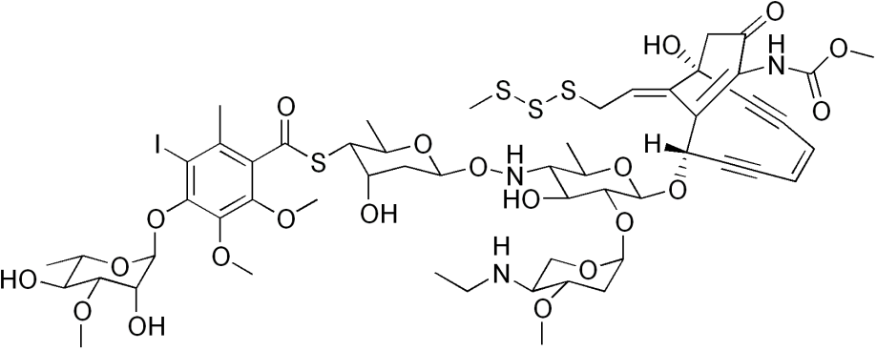
Which of the following are polyketides?
A) alpha-Ionone
B) Bisabolene
C) Resveratrol
D) Calicheamycin
Notes:
You should understand terms like ‘glycoside’ ‘terpenoid’ ‘polyketide’ and be able to recognize them in a molecule

Slide 20
What is the lact operon, and what type of regulation is it?
Transcriptional Control
Translational Control
Post-Translational Control
Notes:
You should understand transcriptional, translation, and post-translational control. I don’t expect you to necessarily know what’s going on in some particular system like the lac operon.

Slide 21
If I put a stop codon into an enzyme and control its expression with a suppressor tRNA, what kind of control is this?
Transcriptional Control
Translational Control
Post-Translational Control
Notes:
Again, I expect you to recognize these types of regulation and their distinction

Slide 22
Find an example of a catalase that can be used as a protein-coding part in E. coli
Catalase expression coli
Notes:
I expect you to know how to look up this sort of info

Slide 23
Find a promoter controlled by VirF in shigella
Google: virF activation lacZ shigella
Notes:
I expect you to know how to look up this sort of info

Slide 24

Write differential equations that describe the kinetics of this system:
Notes:
I expect you to be able to reduce a set of chemical equations to differential equations.

Slide 25
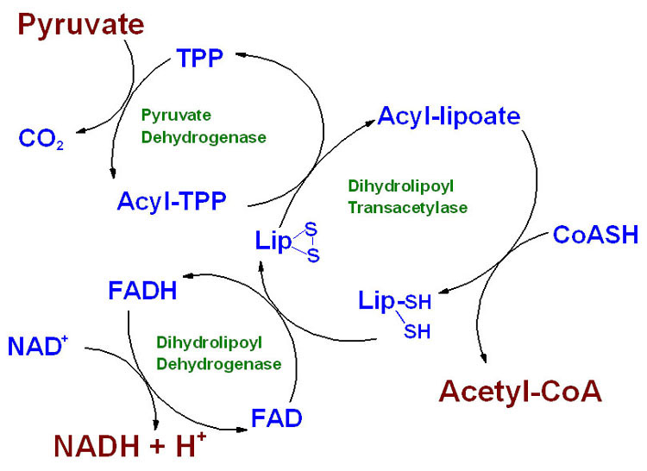
How many species are present in this system?
Notes:
I expect you to be able to look at a biochemical diagram and identify the distinct species present

Slide 26
Write the stoichiometry matrix for the following system:
Notes:
I expect you to be able to reduce a set of chemical equations to a stoichiometry matrix

Slide 27
What are some other ways to orthogonalize a biosynthetic pathway?
Notes:
A point of discussion, but you should generally understand what is meant by making a pathway orthogonal

Slide 28
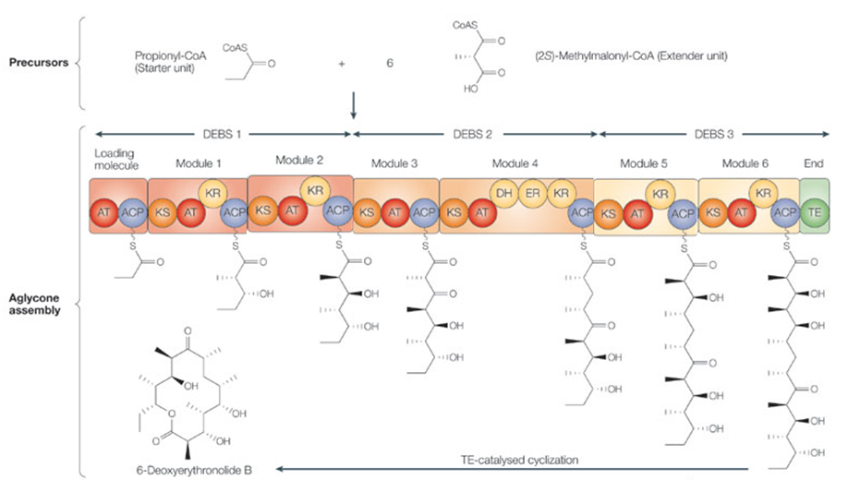
What chemical might result from switching modules 2 and 5?
Notes:
You should understand what the different domains of a PKS and NRPS system do and know what goes into a module

Slide 29
Draw out one step of fatty acid biosynthesis showing the structures of the intermediates and pushing the arrows.
Notes:
The fatty acid reaction sequence is so common that you should be able to draw it out.

